Slide 1
Software Engineering
Introduction
Kaleem Ullah
kaleemullah@pucit.edu.pk
Punjab University College of Information Technology

Slide 2
Course Objectives
Importance and need of software engineering
To discuss software development models appropriate for the development and maintenance of software products
To introduce basic project management concepts
To impart comprehensive knowledge regarding software development lifecycle
To demonstrate, with justification, an appropriate set of tools to support the development of a range of software projects

Slide 3
Course Material
Course Book
Roger Pressman, Software Engineering, 7th Edition, Mcgraw Hill.

Slide 4
Course Outline
Motivate the need for software engineering
Software vocabulary
Software Process Models
Project Management Concepts
Software metrics
Project scheduling
Requirements engineering
Enterprise architecture
Component level design
Software Testing/quality assurance

Slide 5
Course Evaluation
Sessional (25)
Assignments (5 marks)
Quizes (10 marks)
Project (10 marks)
Mid Term (35 marks)
Final Term (40 marks)

Slide 6
The Course

Slide 7
Software Engineering Defined
The textbook description of software is
Instructions that when executed provide desired function and performance
Data structures that enable the programs to adequately manipulate information

Slide 8
S/W characteristics different from H/W
But a formal definition won’t improve your understanding
Software is developed or engineered (not manufactured)
Software does not wear out…

Slide 9
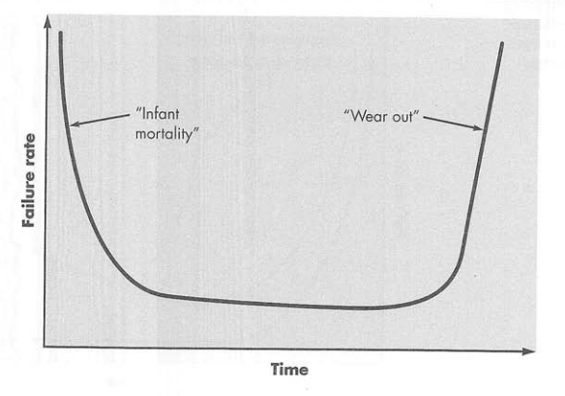
S/W characteristics different from H/W
Failure curve for hardware
(bathtub curve)

Slide 10
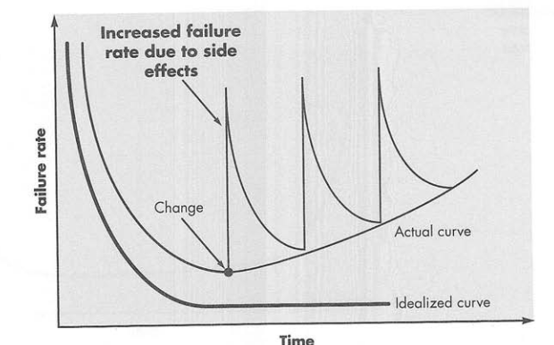
S/W characteristics different from H/W
Failure curve for software
(every failure indicate error in design)

Slide 11
S/W characteristics different from H/W
Software is developed or engineered (Not manufactured)
Software does not wear out
Industry is moving towards component-based construction most software continues to be custom built
Computer hardware components (I.C, chips)
In hardware world components reuse is natural part

Slide 12
Software Engineering Defined
IEEE [IEEE93]: Software Engineering:
(1) The application of systematic, disciplined, quantifiable approach to the development, operation, and maintenance of software; that is, the application of engineering to software
(2) The study of approaches as in (1) for all types of softwares

Slide 13
Software Application Domains
System software (Service other programs like compilers, operating system)
heavy interaction with hardware
Application Software
Stand alone programs to solve specific business needs (point of sale)
Engineering/scientific applications
Astronomy, molecular biology
Embedded software (keypad control for microwave oven)
Web apps

Slide 14
Legacy Software
Developed decades ago and have been continually modified to meet changes
Issues
Non existent documentation
Inextensible code
Test cases and results missing
Poorly managed changed history

Slide 15
Software Engineering: A Layered Approach
Tools
Methods
Process
A Quality Focus

Slide 16
Software Process: A layered approach
Foundation of software engineering is the process layer
Software engineering approach must rest on organizational commitment to quality to continuous improvement culture
Software engineering process is the glue that holds the technology together for rational and timely development of computer software
Process defines a framework that must be established for effective delivery of software technology

Slide 17
Software Process: A layered approach
Methods provide the technical how-to’s for building software
Encompass broad range of tasks that include communication, requirements analysis, design modeling, program construction, testing and support
Method rely on a set of principles that govern software development
Tools provide automated, semi-automated support for the process and methods. Also called computer aided-software engineering

Slide 18
Early Software Engineering Practice
Before computers (essence of problem solving)
Understand the problem (communication and analysis)
Plan a Solution (modeling and software design)
Carry out the plan (code generation)
Examination the result for accuracy (testing the quality assurance)

Slide 19
Early Software Engineering Practice
✔
Understand the problem
I get it, lets solve! Wait..
Who has a stake in the solution to the problem?
What are the unknowns? Functions, data features required to solve problem
Can the problem be compartmentalized (represent smaller problems)?
Can the problem be represented graphically?

Slide 20
Early Software Engineering Practice
✔
Plan the solution
Now I understand the problem, lets code.. Wait!
Have you seen similar problems before?
Has a similar problem been solved (can solution elements be reused)
Can sub-problems be defined?
Can you represent a solution in a manner that leads to effective implementation (create design model)

Slide 21
Early Software Engineering Practice
✔
Carry out the plan
Does the solution conform to the plan?
Is source code traceable to the design model?
Is each component part of the solution provably correct
Have the design and code been reviewed, correctness proof

Slide 22
Early Software Engineering Practice
✔
Examine the result
Is it possible to test each component part of the solution?
Is source code traceable to the design model?
Does the solution produce results that conform to the data, functions, and features that are required

Slide 23
Early Software Engineering Practice
Before computers
Understand the problem (communication and analysis)
Plan a Solution (modeling and software design)
Carry out the plan (code generation)
Examination the result for accuracy (testing the quality assurance)
✔

Slide 24
Questions?

Slide 25
Software Myths
Management
We have standards
Is it followed, complete, improves quality
We’ll add more people to catch up
Old people will spend time educating new
I outsourced it, I’m done
if you cannot manage internally, you will struggle

Slide 26
Software Myths
Customer
We have general objectives, let’s start
a n ambiguous “statement of objectives“ is a recipe for disaster
Change is easily accommodated
Later requirements may require major design changes

Slide 27
Software Myths
Practitioner
We’ll write it and be done
I can’t assess quality until it is running
My only deliverable is the working code
Software engineering is about meaningless documents (SE-> quality-> reduced rework ->faster delivery)

Slide 28
Reference
Text book: Chapter # 1

Slide 29
Software Process

Slide 30
Software Process
Series of predictable steps-a road map that helps create a timely and high quality entity
Process
Software Process is a framework for the tasks that are required to build high quality software to create timely and high quality result

Slide 31
Software Process
Is Software Process, Software Engineering ?
Answer: Yes and No Both…Why?
Yes because it defines an approach which is known as Software Engineered
No because Software Engineering also entails technologies that populate the process…technical methods and automated tools.

Slide 32
Software Process
Process is a collection of activities, actions and tasks that are performed when some work is to be created
An activity strives to achieve broad objective
An action encompasses a set of tasks that produce a major work product
A task focuses on a small, well defined objective
Work Product: Programs, documents and data that are produced as a consequence of activities

Slide 33
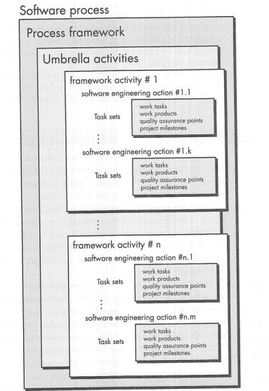
Software Process
Each software engineering process is populated by software action/activities
Each software engineering action is defined by a task set.
Task set identifies the work tasks that are to be completed, the work products that will be produced, the quality assurance points that will be required and the milestones that will be used

Slide 34
Software Process
Generic process framework for software engineering encompasses five activities
Communication
with customer, identify project objectives, gather requirements to define software features and functions
Planning
Software project plan
Define technical tasks, risks, resources required, work product, and the work

Slide 35
Software Process
Generic process framework for software engineering encompasses five activities
Modeling
Create sketch, what it looks like architecturally
Construction
Code generation and testing
Deployment
Deliver to customer to evaluate delivered product and provide feedback
Example ->

Slide 36
umbrella activities
project tracking and control,
risk management,
quality assurance,
configuration management,
technical reviews,
and others-are applied throughout the process

Slide 37
Software Process
Before the relationship between these activities… Tasks of activities
For small project
Communication activity encompasses:
Action: phone conversation
Tasks:
Make contact with stakeholder via telephone
Discuss requirements and take notes
Organize notes into written statement of requirements
Email stakeholder for review and approval

Slide 38
CMM-Introduction
Comprehensive model developed by SEI based on a set of software engineering capabilities that should be present as organizations reach different level of maturity.
CMM defines key activities at different levels of maturity.
CMM establishes five maturity levels
Initial
Repeatable
Defined
Managed
Optimizing

Slide 39
CMM-Introduction
CMM establishes five maturity levels
Initial - starting point for use of a new or undocumented process.
Repeatable: some processes are repeatable, possibly with consistent results.
Defined: sets of defined and documented standard processes established and subject to some degree of improvement over time
Managed: management can identify ways to adjust and adapt the process to particular projects without measurable losses of quality
Optimizing: focus is on continually improving process performance

Slide 40
CMM-Introduction
CMM establishes five maturity levels
Each level has a certain set of KPAs(Key Process Areas), which are software engineering functions needed at a particular level
Process Area is a cluster of related practices in an area that, when implemented collectively, satisfy a set of goals

Slide 41
CMM Summary

Slide 42
Software Process Models

Slide 43
Linear Sequential model
Adopted from the typical enigeering approach i.e civil engineering.
Also known as the classic life cycle or waterfall
model, it suggests a systematic, sequential approach to software development that begins at the system level and progress through analysis, design, coding, testing and support.

Slide 44
Linear Sequential model
System/information
engineering
Requirements
Analysis
Design
Coding
Testing
Maintenance

Slide 45
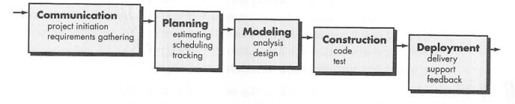
Linear Sequential model

Slide 46
Linear Sequential model
Usage
Some times encountered when well-defined adaptations or enhancements to an existing system are to be made
e.g. an adaptation to accounting software to accommodate the changes due to government regulation.

Slide 47
Linear Sequential model
Limitations
Real projects rarely follow the sequential flow and changes can cause confusion.
This model has difficulty accommodating requirements change
The customer will not see a working version until the project is nearly complete
Developers are often blocked unnecessarily, due to previous tasks not being done

Slide 48
Prototyping
The developer and customer define the overall objectives for the software. A quick design focuses on what the customer will see. From this, a prototype is constructed. The user evaluates it and improvements are made. This continues in an iterative fashion until a satisfactory product is achieved.
Usually used to collect the requirements
Ususally used with aspects of the software that will be visible to end users (interface layout or output display format)
What to do after prototype serves the purpose?
“Throwaway” or
Use as “the first system”

Slide 49
Prototyping
Engineer
Product
Requirements
No
Quick
Design
Yes
Changes?
Build
Prototype
Refine
Prototype
Evaluate
Prototype
(Pressman, 1996)

Slide 50
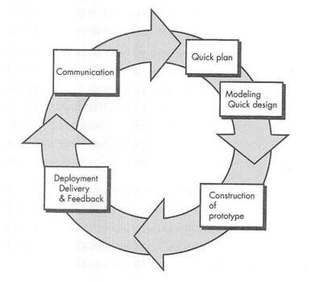

Slide 51
Prototyping – When useful
Often customer define general objectives i.e. no detailed requirements for functions & features
Other case: developer may be unsure of efficiency of algo., or the form for human-machine interaction should take
In addition, there may be a compelling need to provide a limited set of software functionality to users quickly and then refine and expand on that functionality in later software release
Prototyping offers the best approach

Slide 52
Prototyping - Limitations
The customer sees a working version and expects the finished product to be available in a short time. This puts pressure on the developer to take short cuts
The developer may make compromises for speed
Inappropriate tools may be used or inefficient algorithms may be used, which then become integral parts of the system.
If the user isn’t focused on what they want, the system may never be completed.

Slide 53
Ground Realities
Software evolves
Business and product requirements change – creeping requirements
Tight market deadlines compels for a limited version

Slide 54
The RAD model
Rapid Application Development is a linear sequential software development process model that emphasises an extremely short development cycle.
A component-based construction approach is used.
To use this approach, the project scope must be constrained and the requirements should be well understood.
A task that should take no more than ninety days to complete is modelled, generated and implemented.
There can be several teams working on different components during this ninety day time-box.

Slide 55
The RAD model
Team 1
Team 2
Team 3
Business modelling
Business modelling
Business modelling
Data modelling
Data modelling
Data modelling
Process modelling
Process modelling
Process modelling
90 days
Application
Generation
Application
Generation
Application
Generation
Testing & Turnover
Testing & Turnover
Testing & Turnover
.The RAD model (Pressman 1997)

Slide 56
Problems with RAD
For large, scalable projects, RAD requires sufficient human resources to create the right number of RAD teams
RAD requires developers and customers who are committed to the rapid-fire activities necessary to complete a system in this time frame, or failure will result.
RAD is not suitable for many project types.

Slide 57
Evolutionary Software Process Models:
Software Evolves
Business and product requirements change-Creeping requirements
Tight market deadlines compels for a limited version
Details of the product
Above issues cannot be answered by Linear sequential or by prototyping approach

Slide 58
Questions?

